Slide 1
Python programming
unit A – Scipy ecosystem

Slide 2
Scipy ecosystem
NumPy: the fundamental package for numerical computation. It defines the numerical array and matrix types and basic operations on them.
SciPy: a collection of numerical algorithms and domain-specific toolboxes, including signal processing, optimization, statistics, and much more.
Matplotlib: a mature and popular plotting package that provides publication-quality 2-D plotting, as well as rudimentary 3-D plotting.
Pandas: providing high-performance, easy-to-use data structures.
SymPy: for symbolic mathematics and computer algebra.
IPython: a rich interactive interface, letting you quickly process data and test ideas.
Jupyter: provides IPython functionality and more in your web browser, allowing you to document your computation in an easily reproducible form.

Slide 3
Using jupyter
Installation:
Start:
jupyter-lab
pip install jupyterlab
conda install -c conda-forge jupyterlab

Slide 4
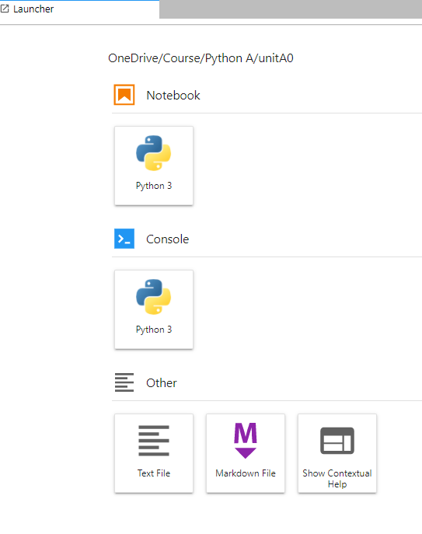
Jupyter notebook
On start, jupyter lab will show the launcher page.
Create notebook Python 3. We work in notebook to test for our data processing ideas

Slide 5
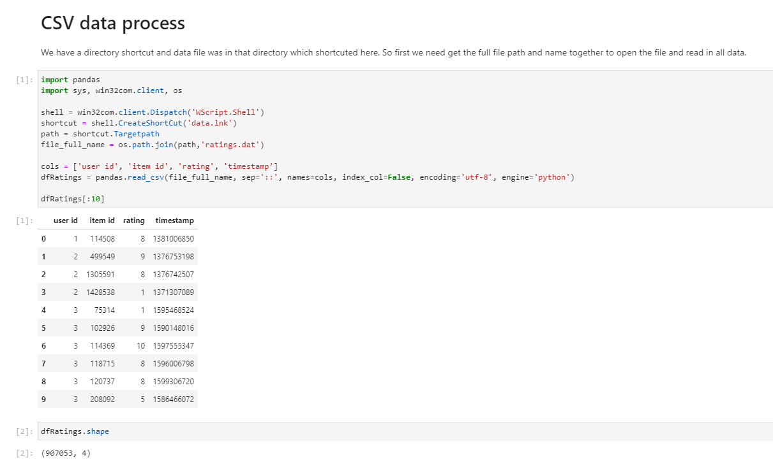
Jupyter notebook
Two type of cells:
Markdown for text, table, etc.
Code for python code and execution.

Slide 6
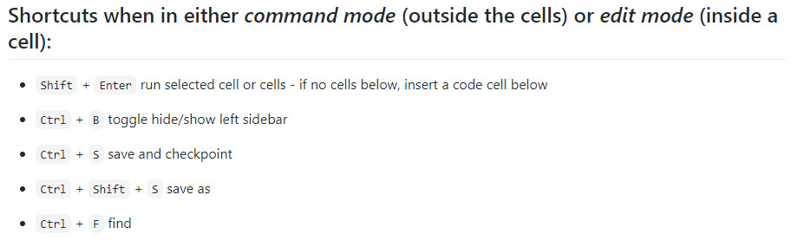
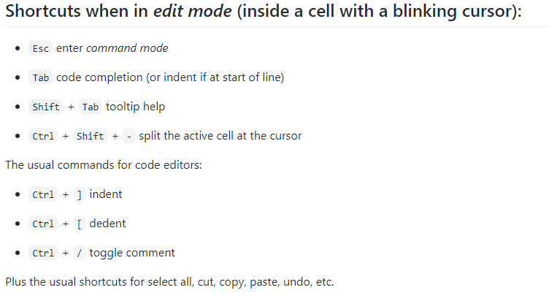

Slide 7
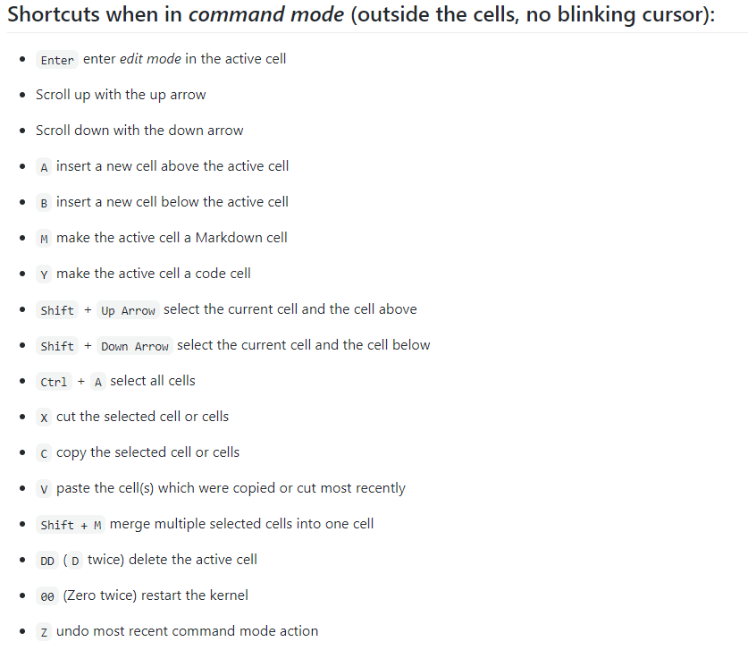

Slide 8
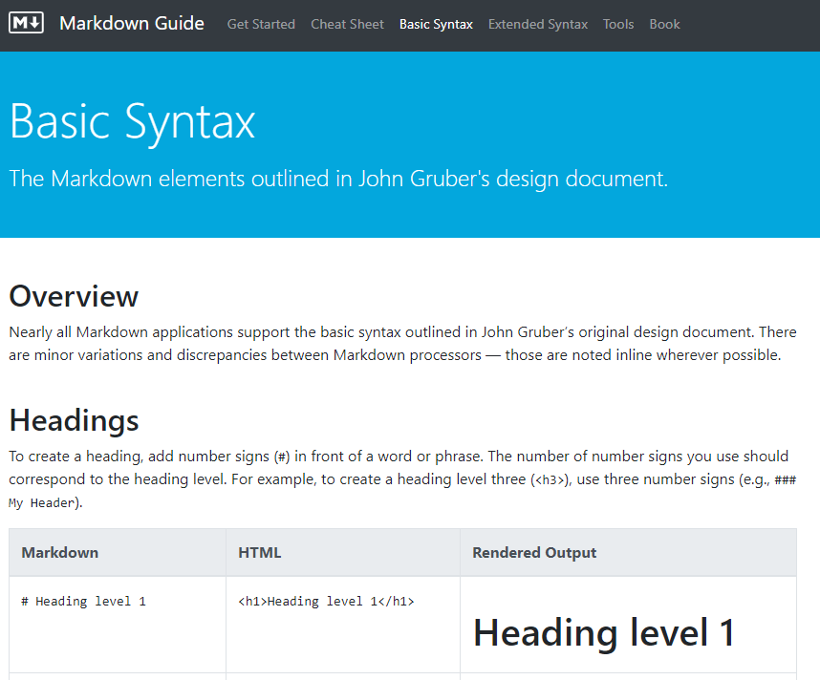
Markdown guide
Visit http://markdownguide.org
Learn syntax.

Slide 9
numpy
NumPy provided the support of array data type. Compare to python list data type this can reduce the memory consumption, increase the process speed
Use:
import numpy, then use in your program.
pip install numpy

Slide 10
Create array
Create from python collection data, list or tuple.
After creation, the array data and original python list or tuple data will be independent with each other.
Set and dict, the items are not ordered. So cannot be used to create array.
If the items in list-or-tuple is again list-or-tuple, they should be same shape, and create multidimensional array. If not same shape, then the creation maybe not you expected.
Useful attributes of array
Array reshape()
Special numpy functions, like zeros(), ones(), linspace(), arange(), etc.
Create from data in a file, using fromfile(), or load(), loadtxt()/genfromtxt()
Customize dtype

Slide 11
Indexing and slicing
Similar to python indexing and slicing for list.
Multiple dimension, using only one pair square brackets, different dimension index separated by ‘,’
A[0:2, -2:]
Arbitrary position subarray
Take 2D as example: A[[[0],[2],[4]], [3,5]] (understand the rule of broadcast)

Slide 12
Item selection: with bool array
The original array and bool array has same shape.
Use bool array as subscript in square bracket, will filter and keep only those position with ‘True’ value.
This combined with condition test can flexibly selection items from array.

Slide 13
broadcast
If have same shape number, is compatible.
If one of the shape number is 1, is compatible.
Arithmetic operator: broadcast
Array a shape is (3,1,2), a = numpy.array([[[1,2]],[[3,4]],[[5,6]]])
Array b shape is (3,1), b = numpy.array([[7],[8],[9]])
a*b will have shape (3,3,2)
(3, 1, 2)
[[[1,2],[1,2],[1,2]],[[3,4],[3,4],[3,4]],[[5,6],[5,6],[5,6]]]
(3, 1)
[[[7,7],[8,8],[9,9]],[[7,7],[8,8],[9,9]],[[7,7],[8,8],[9,9]]]
(3, 3, 2)
[[[7,14],[8,16],[9,18]],[[21,28],[24,32],[27,36]],[[35,42],[40,48],[45,54]]]
If two array exact same shape they compatible, do calculation by each corresponding item

Slide 14
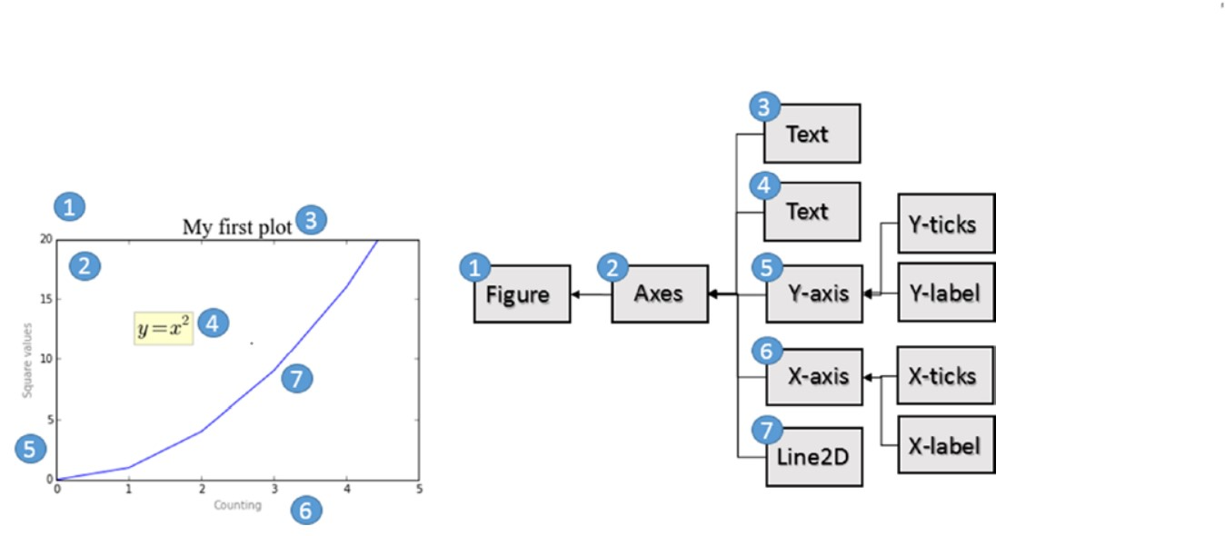
matplotlib
Create and manipulate attributes of different objects.

Slide 15
Pandas
Pandas is a Python library used for working with data sets.
It has functions for importing, cleaning, exploring, and manipulating data.
Install:
Use:
import pandas, then use in your program.
pip install pandas
Data Science: is a branch of computer science where we study how to store, use and analyse data for deriving information/knowledge from it.

Slide 16
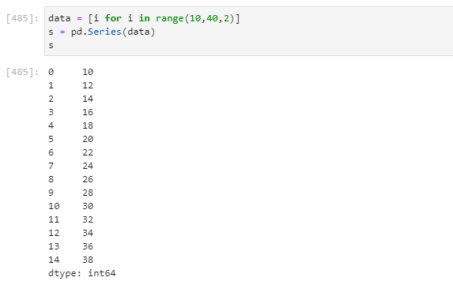
series
Series is one column data. (or one row data)
Create series (with python iterable like list or tuple)
Indexing, slicing (integer position slicing, is same behaviour like python and numpy array. But using index slicing it will include the end).
Add item, remove item, update item
When creating series from numpy array (numeric): share same data copy
When creating series from another series: share the index and numpy array data.
Filtering and selection of items
Arithmetic operation. (series with series, match the index to perform item with item calculation.)

Slide 17
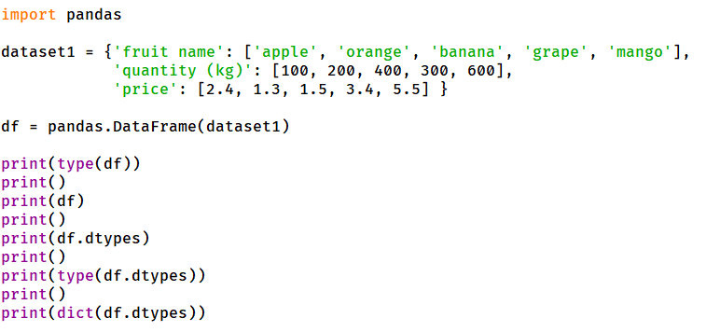
Create dataframe from dict
Dataframe is a table, can have many rows of data
Create dataframe from python dict.
Keys become column name
Values lists become row of data

Slide 18
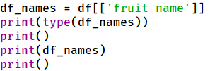
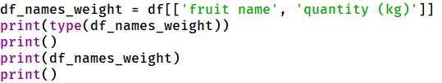
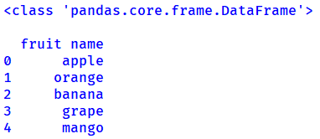
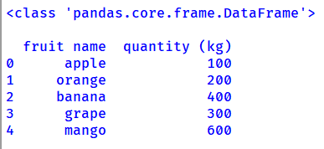
select some columns from a dataframe
Can take few columns from dataframe form a new view, to easy manipulate less data involved.
Don’t mistake one column dataframe with series. They are different data structure, different class

Slide 19


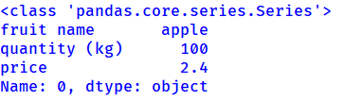

select some rows from a dataframe
Every row is a data record. Can select rows based on the value of some column
When slice several record, the returned result is a dataframe.
When only select one row, the returned result is a series.

Slide 20
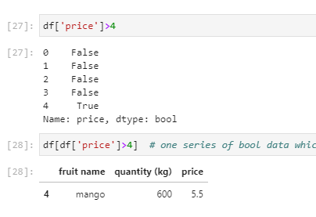
Filtering with bool
The same length bool array can be used to filter rows.

Slide 21
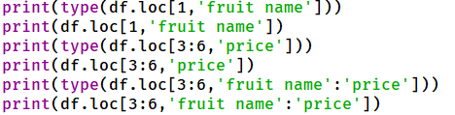
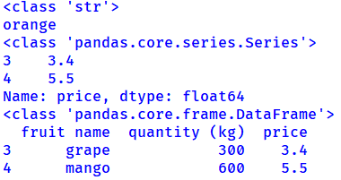
Selection of dataframe
When selecting to one cell only, the result will be a normal python data type and value (scalar)
When selecting to one row, or one column, the result will be a pandas series
When selecting to more than one row and more than one column, the result is a dataframe

Slide 22
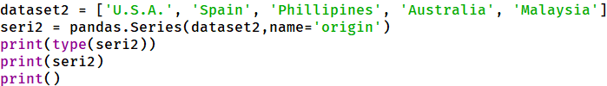

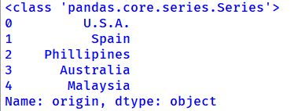
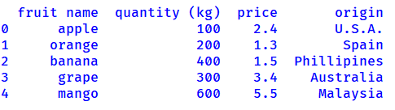
Create series, add column to dataframe
Create series
Can add series to dataframe as new column
Also can add column with python list data

Slide 23
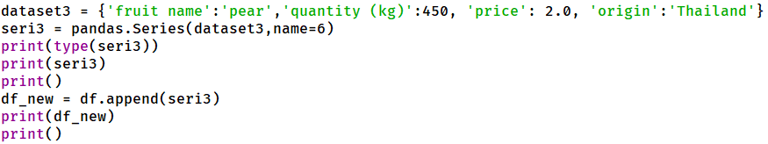
Add new record (row)
Create series
Can add series to dataframe as new row
Also can add row with python dict data

Slide 24
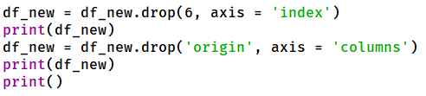
Delete row, or column
drop()

Slide 25
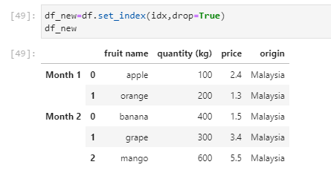
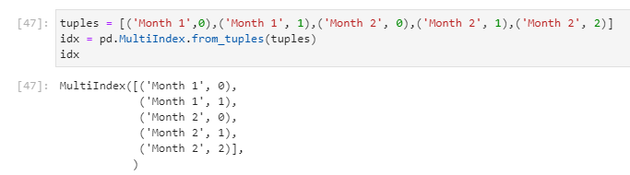
Multiindex
Can be used for both row index, or columns labels.
Give multiple level in the indexing and can use different level to easily do some selection.
Create multiindex: typically can use a list of tuples (or zip() result), or use 2 or more lists (from_product()).
set_index()

Slide 26
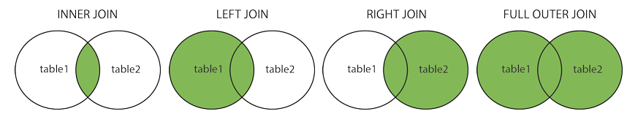
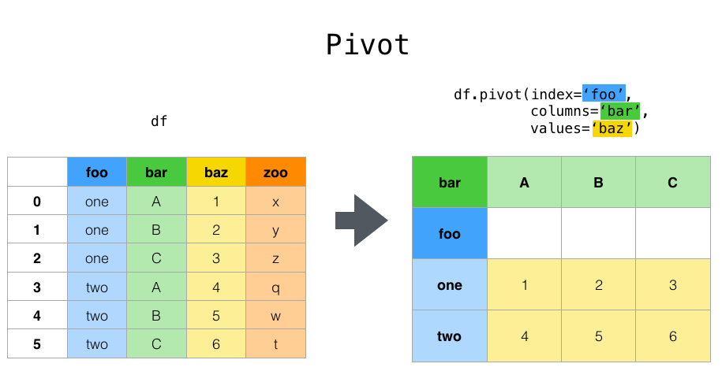
Data manipulation
Merge
pivot

Slide 27
datamanipulation
Series.map() -- itemwise data manipulation
Series.apply() -- itemwise, but can return one series for one item, then result will be dataframe
Series.transform() -- itemwise, and must be same shape. So works quite similar to map.
DataFrame.applymap() -- itemwise data manipulation
DataFrame.apply() -- by one col or row, as series. Can change shape
DataFrame.transform() -- by one col or row, as series. Must keep same shape
GroupBy.apply() -- by one col or row, as series. Can change shape
GroupBy.transform() -- by one col or row, as series. Must keep same shape. If return one scalar then will do broadcast to fit the shape (the broadcast is different from the DataFrame.transform())

